Slide 1
CS 355/555
Probability and Statistics for CS
Baocheng Geng
Lecture 2
January 12, 2023
CS 355/555 Probability and Statistics for CS

Slide 2
Copyright Statement
Copyright Statement
Materials prepared for and/or included in this course are protected by copyright law. They are intended to be used only by students enrolled in this course during the current term and should not be further disseminated without prior permission from the course instructor.
CS 355/555 Probability and Statistics for CS

Slide 3
Anouncements
Programming assignment: individual or group
Group up to 2 members
Group responsibilities
Form your groups before the 5th week.
2
CS 355/555 Probability and Statistics for CS

Slide 4




Introduction to the Class
1 Introduction
2
Set Theory Basic Concepts
Set Theory Proof
4
Next Time
CS 355/555 Probability and Statistics for CS

Slide 5
Set Theory Basic Concepts
Definition
A set is a collection of objects, called elements
CS 355/555 Probability and Statistics for CS
4/28 14:38

Slide 6
Set Theory Basic Concepts
Definition
A set is a collection of objects, called elements
Notation
A = {a, b, c}
CS 355/555 Probability and Statistics for CS
4/28 14:38

Slide 7
Set Theory Basic Concepts
Definition
A set is a collection of objects, called elements
Notation
A = {a, b, c}
A = {a, b, c, . . . z}
CS 355/555 Probability and Statistics for CS
4/28 14:38

Slide 8
Set Theory Basic Concepts
Definition
A set is a collection of objects, called elements
Notation
A = {a, b, c}
A = {a, b, c, . . . z}
A = {1, 2, 3, . . . }
CS 355/555 Probability and Statistics for CS
4/28 14:38

Slide 9
Set Theory Basic Concepts
Definition
A set is a collection of objects, called elements
Notation
A = {a, b, c}
A = {a, b, c, . . . z}
A = {1, 2, 3, . . . }
A = {a|a satisfies some rule}
CS 355/555 Probability and Statistics for CS
4/28 14:38

Slide 10
Set Theory Basic Concepts
Finite
A = {a, b, c}
CS 355/555 Probability and Statistics for CS

Slide 11
Set Theory Basic Concepts
Definition - Countable
There is a one-to-one and onto function f : $N^{+}$ → A
Countable
A = {1, 2, 3, 4, 5, 6, . . . }
CS 355/555 Probability and Statistics for CS
6/28 14:38

Slide 12
Set Theory Basic Concepts
Definition - Countable
There is a one-to-one and onto function f : $N^{+}$ → A
Countable
A = {1, 2, 3, 4, 5, 6, . . . }
Countable
A = {0, 2, 4, 6, 8, . . . }
f (n) = 2n − 2
CS 355/555 Probability and Statistics for CS
6/28 14:38

Slide 13
Set Theory Basic Concepts
Countable
A = {. . . , −3, −2, −1, 0, 1, 2, 3, . . . }
CS 355/555 Probability and Statistics for CS

Slide 14
Set Theory Basic Concepts
Uncountable
A = [0, 1]
CS 355/555 Probability and Statistics for CS
8/28 14:38

Slide 15
Set Theory Basic Concepts
Uncountable
A = [0, 1]
Uncountable
A = R
CS 355/555 Probability and Statistics for CS
8/28 14:38

Slide 16
Set Theory Basic Concepts
Countable？
A = {r|r = ^{p} }, p,q integers
q
 | 1 | 2 | 3 | 4 | 5 | 6
1
2
3
4
5
6
CS 355/555 Probability and Statistics for CS

Slide 17
Set Theory Basic Concepts
Countable
A = {r|r = ^{p} }, p,q integers
q
 | 1 | 2 | 3 | 4 | 5 | 6
1 | 1 | 2 | 4 | 7 | 11 | 16 | 22
2 | 3 | 5 | 8 | 12 | 17 | 23
3 | 6 | 9 | 13 | 18 | 24
4 | 10 | 14 | 19 | 25
5 | 15 | 20 | 26
6 | 21 | 27
 | 28
CS 355/555 Probability and Statistics for CS

Slide 18
Set Theory Basic Concepts
Let A = {1, 2, 3, 4, 5, 6, 7, 8}.
CS 355/555 Probability and Statistics for CS
11/28 14:38

Slide 19
Set Theory Basic Concepts
Let A = {1, 2, 3, 4, 5, 6, 7, 8}.
Empty set
ϕ = {}
CS 355/555 Probability and Statistics for CS
11/28 14:38

Slide 20
Set Theory Basic Concepts
Let A = {1, 2, 3, 4, 5, 6, 7, 8}.
Empty set Universe
ϕ = {}
Ω
CS 355/555 Probability and Statistics for CS
11/28 14:38

Slide 21
Set Theory Basic Concepts
Let A = {1, 2, 3, 4, 5, 6, 7, 8}.
Empty set ϕ = {}
Universe Ω Membership/ Element of
x ∈ A
1 ∈ A
CS 355/555 Probability and Statistics for CS
11/28 14:38

Slide 22
Set Theory Basic Concepts
Let A = {1, 2, 3, 4, 5, 6, 7, 8}.
Empty set ϕ = {}
Universe Ω Membership/ Element of
x ∈ X
1 ∈ A
9 ∈/ A
CS 355/555 Probability and Statistics for CS
11/28 14:38

Slide 23
Set Theory Basic Concepts
Let A = {1, 2, 3, 4, 5, 6, 7, 8}.
Empty set ϕ = {}
Universe Ω Membership/ Element of
x ∈ X
1 ∈ A
9 ∈/ A
Subset
B ⊂ A
{1, 2, 3} ⊂ A
CS 355/555 Probability and Statistics for CS
11/28 14:38

Slide 24
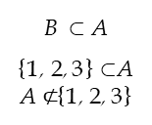
Set Theory Basic Concepts
Let A = {1, 2, 3, 4, 5, 6, 7, 8}.
Empty set ϕ = {}
Universe Ω Membership/ Element of
x ∈ X
1 ∈ A
9 ∈/ A
Subset
B ⊂ A
{1, 2, 3} ⊂A
A $⊄${1, 2, 3}
CS 355/555 Probability and Statistics for CS
11/28 14:38

Slide 25
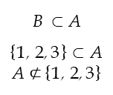
Set Theory Basic Concepts
Let A = {1, 2, 3, 4, 5, 6, 7, 8}.
Empty set ϕ = {}
Universe Ω Membership/ Element of
x ∈ X
1 ∈ A
9 ∈/ A
Subset
B ⊂ A
{1, 2, 3} ⊂ A
A $⊄$ {1, 2, 3}
a ∈ B ⇒ a ∈ A
Venn Diagram
CS 355/555 Probability and Statistics for CS
11/28 14:38

Slide 26
Set Theory Basic Concepts - Union
C = A ∪ B
C is all elements of Ω that are in either A or B.
x ∈ C means x ∈ A or x ∈ B or x is in both.
CS 355/555 Probability and Statistics for CS
12/28 14:38

Slide 27

Set Theory Basic Concepts - Union
C = A ∪ B
C is all elements of Ω that are in either A or B. x ∈ C means x ∈ A or x ∈ B or x is in both.
$$C=\bigcup_{i=1}^{n}{A_{i}}$$
C is all elements of Ω that are in some A_{i}. x ∈ C means x ∈ A_{i} for at least one i
CS 355/555 Probability and Statistics for CS
12/28 14:38

Slide 28
Set Theory Basic Concepts - Intersection
C = A ∩ B
C is all elements of Ω that are in both A and B.
x ∈ C means x ∈ A and x ∈ B.
CS 355/555 Probability and Statistics for CS
13/28 14:38

Slide 29

Set Theory Basic Concepts - Intersection
C = A ∩ B
C is all elements of Ω that are in both A and B. x ∈ C means x ∈ A and x ∈ B.
$$C=\bigcap_{i=1}^{n}{A_{i}}$$
C is all elements of Ω that are in every A_{i}. x ∈ C means x ∈ A_{i} for every i
CS 355/555 Probability and Statistics for CS
13/28 14:38

Slide 30
Set Theory Basic concepts - Disjoint
Disjoint
A and B are disjoint means A ∩ B = ϕ.
CS 355/555 Probability and Statistics for CS

Slide 31

Set Theory Basic Concepts - Partition
Partition {A_{i}}^{n} of the set A
i=1
$A=U_{i=1}^{n}A_{i}$ and all of the A_{i} s are disjoint
CS 355/555 Probability and Statistics for CS
15/28 14:38

Slide 32

Set Theory Basic Concepts - Partition
Partition {A_{i}}^{n} of the set A
i=1
Partition {A_{i}}^{n} of the set A
i=1
$A=U_{i=1}^{n}A_{i}$ and all of the A_{i} s are disjoint
Let A = {1, 2, 3, 4, 5, 6, 7, 8}.
{1, 2, 3}, {4, 5, 6}, {7, 8}
is a partition of A
CS 355/555 Probability and Statistics for CS
15/28 14:38

Slide 33
Set Theory Basic Concepts - Complement
Complement A^{C}
All the elements of Ω that are not in A
CS 355/555 Probability and Statistics for CS
16/28 14:38

Slide 34
Set Theory Basic Concepts - Complement
Complement A^{C}
All the elements of Ω that are not in A
Let R = rational numbers.
R^{C} is all irrational numbers
CS 355/555 Probability and Statistics for CS
16/28 14:38

Slide 35
Set Theory Basic Concepts - Complement
Complement A^{C}
All the elements of Ω that are not in A
Let R = rational numbers.
R^{C} is all irrational numbers
A^{C} = Ω \ A
CS 355/555 Probability and Statistics for CS
16/28 14:38

Slide 36
Set Theory Basic Concepts - Set Subtraction
Set Subtraction
A \ B is all the elements that are in A and not in B
CS 355/555 Probability and Statistics for CS
17/28 14:38

Slide 37
Set Theory Basic Concepts - Set Subtraction
Set Subtraction
A \ B is all the elements that are in A and not in B
{1, 2, 3, 4, 5} \ {1, 3, 5, 7, 9} = {2, 4}
CS 355/555 Probability and Statistics for CS
17/28 14:38

Slide 38
Set Theory Basic Concepts - Set Subtraction
Set Subtraction
A \ B is all the elements that are in A and not in B
{1, 2, 3, 4, 5} \ {1, 3, 5, 7, 9} = {2, 4}
A \ B = A ∩ B^{C}
CS 355/555 Probability and Statistics for CS
17/28 14:38

Slide 39
The Power Set of A ⊂ Ω, written 2^{A} is
2^{A} = {B : B ⊂ A}
Set Theory Basic Concepts - Power Set
Power Set
CS 355/555 Probability and Statistics for CS
18/28 14:38

Slide 40
Set Theory Basic Concepts - Power Set
Power Set
The Power Set of A ⊂ Ω, written 2^{A} is
2^{A} = {B : B ⊂ A}
Let A = {a, b, c}
2^{A} = {{}, {a}, {ab}, {b}, {c}, {ac}, {bc}, {a, b, c}}
CS 355/555 Probability and Statistics for CS
18/28 14:38

Slide 41
Set Theory Basic Concepts - Power Set
Let A = {a, b, c}
2^{A} = {{}, {a}, {ab}, {b}, {c}, {ac}, {bc}, {a, b, c}}
Look at binary numbers if n bits, where n = #A.
0 | 0 | 0
0 | 0 | 1
0 | 1 | 0
0 | 1 | 1
1 | 0 | 0
1 | 0 | 1
1 | 1 | 0
1 | 1 | 1
CS 355/555 Probability and Statistics for CS

Slide 42
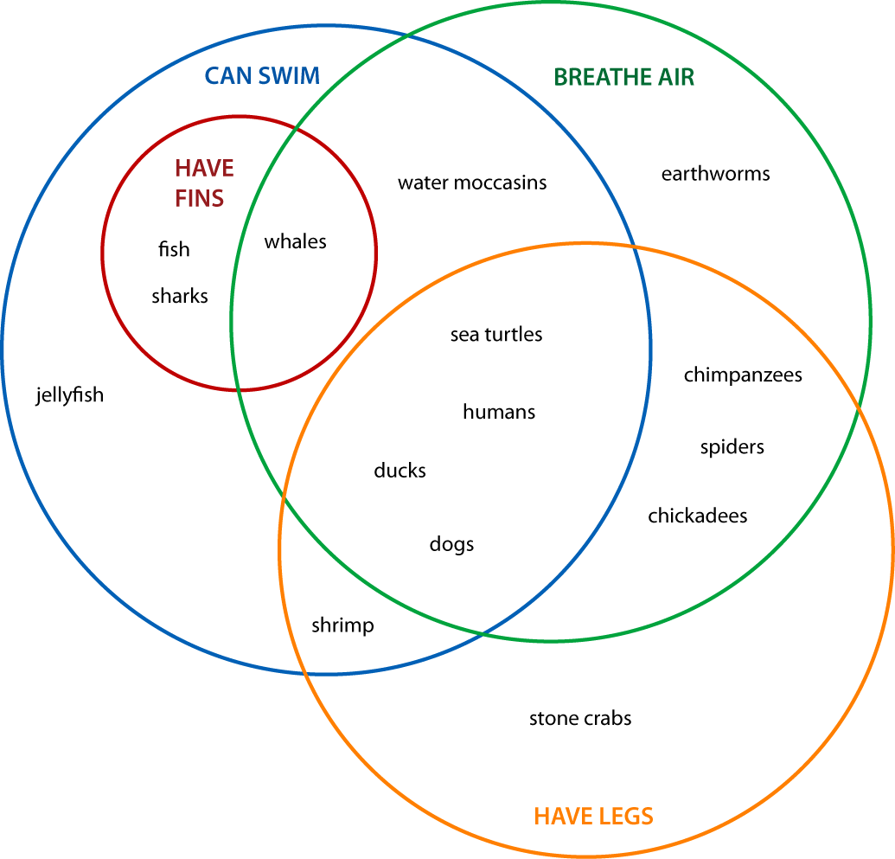
Set Theory Basic Concepts - Venn diagrams
CS 355/555 Probability and Statistics for CS

Slide 43
Set theory Basic Concepts - Venn diagrams
More pictures on page 5 of textbook.
CS 355/555 Probability and Statistics for CS

Slide 44
Proofs - Contrapositive
Show
p ⇒ q
CS 355/555 Probability and Statistics for CS
14/18 14:39

Slide 45
Set Theory Proofs
What is a proof?
Proof
A ⊂ B ⊂ C ⇒ A ⊂ C
A set of statements that we accept as demonstrating the truth of a mathematical statement.
Theorems
A statement (usually mathematical) that has already been proven.
Venn diagram - De Morgan’s Law
Contrapositive*
CS 355/555 Probability and Statistics for CS
6/18 14:39

Slide 46
Set Theory Basic Concepts - Proof
A ⊂ B ⊂ C ⇒ A ⊂ C
Suppose A ⊂ B ⊂ C
CS 355/555 Probability and Statistics for CS
23/28 14:38

Slide 47
Set Theory Basic Concepts - Proof
A ⊂ B ⊂ C ⇒ A ⊂ C
Suppose A ⊂ B ⊂ C
Let a ∈ A
CS 355/555 Probability and Statistics for CS
23/28 14:38

Slide 48
Set Theory Basic Concepts - Proof
A ⊂ B ⊂ C ⇒ A ⊂ C
Suppose A ⊂ B ⊂ C
Let a ∈ A
Then, since A ⊂ B, we have a ∈ B
CS 355/555 Probability and Statistics for CS
23/28 14:38

Slide 49
Set Theory Basic Concepts - Proof
A ⊂ B ⊂ C ⇒ A ⊂ C
Suppose A ⊂ B ⊂ C
Let a ∈ A
Then, since A ⊂ B, we have a ∈ B
Since B ⊂ C, we have a ∈ C
CS 355/555 Probability and Statistics for CS
23/28 14:38

Slide 50
Set Theory Basic Concepts - Proof
A ⊂ B ⊂ C ⇒ A ⊂ C
Suppose A ⊂ B ⊂ C
Let a ∈ A
Then, since A ⊂ B, we have a ∈ B
Since B ⊂ C, we have a ∈ C
Therefore a ∈ A implies a ∈ C, so A ⊂ C
CS 355/555 Probability and Statistics for CS
23/28 14:38

Slide 51
Set Theory Basic Concepts - Distributive Laws
A ∪ (B ∩ C) = (A ∪ B) ∩ (A ∪ C)
A ∩ (B ∪ C) = (A ∩ B) ∪ (A ∩ C)
CS 355/555 Probability and Statistics for CS

Slide 52
Set Theory Basic Concepts - De Morgan’s Laws
(A ∩ B)^{C} = A^{C} ∪ B^{C}
(A ∪ B)^{C} = A^{C} ∩ B^{C}
CS 355/555 Probability and Statistics for CS

Slide 53
In Class
DeMorgan:
(A ∩ B)^{C} = A^{C} ∪ B^{C}
Draw a Venn diagram illustrating this law.
CS 355/555 Probability and Statistics for CS

Slide 54


Proofs - Contrapositive
Show
p ⇒ q
Contrapositive proof:
Assume $¬$q
Prove $¬p$
1
2
$¬$q ⇒ $¬p$
CS 355/555 Probability and Statistics for CS
14/18 14:39

Slide 55
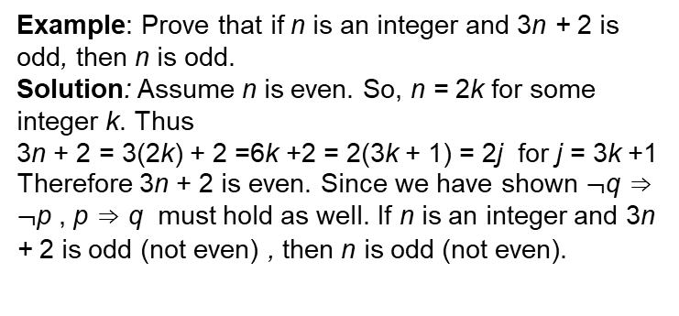
Proofs - Contrapositive
Example: Prove that if n is an integer and 3n + 2 is odd, then n is odd.
Solution: Assume n is even. So, n = 2k for some integer k. Thus
3n + 2 = 3(2k) + 2 =6k +2 = 2(3k + 1) = 2j for j = 3k +1
Therefore 3n + 2 is even. Since we have shown $¬$q ⇒ $¬$p , p ⇒ q must hold as well. If n is an integer and 3n + 2 is odd (not even) , then n is odd (not even).
CS 355/555 Probability and Statistics for CS
7/18 14:39

Slide 56
Inclusion A ⊂ B
Show A ⊂ B
Sketch:
For every a ∈ A, prove a ∈ B, then A ⊂ B.
CS 355/555 Probability and Statistics for CS
10/18 14:39

Slide 57
Inclusion A ⊂ B
Show A ⊂ B
Sketch:
For every a ∈ A, prove a ∈ B, then A ⊂ B.
Let F = set of numbers divisible by 4, E = set of even numbers
m ∈ F m = 4n
m = 2(2n)
m ∈ E
Therefore, F ⊂ E
CS 355/555 Probability and Statistics for CS
10/18 14:39

Slide 58
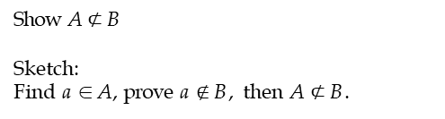
Non inclusion
Show A $⊄$ B
Sketch:
Find a ∈ A, prove a $∉$ B, then A $⊄$ B.
CS 355/555 Probability and Statistics for CS
11/18 14:39

Slide 59
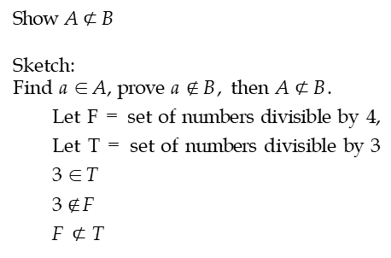
Non inclusion
Show A $⊄$ B
Sketch:
Find a ∈ A, prove a $∉$ B, then A $⊄$ B.
Let F = set of numbers divisible by 4, Let T = set of numbers divisible by 3 3 ∈ T
3 $∉$F F $⊄$ T
CS 355/555 Probability and Statistics for CS
11/18 14:39

Slide 60
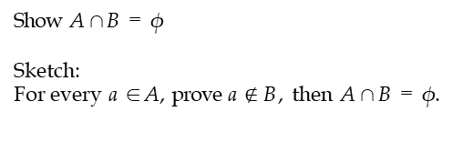
Disjoint
Show A ∩ B = ϕ
Sketch:
For every a ∈ A, prove a $∉$ B, then A ∩ B = ϕ.
CS 355/555 Probability and Statistics for CS
12/18 14:39

Slide 61
Equality
Show X = Y
Sketch:
X ⊂ Y , Y ⊂ X, therefore X = Y
CS 355/555 Probability and Statistics for CS
13/18 14:39

Slide 62
Equality
Sketch:
X ⊂ Y , Y ⊂ X, therefore X = Y
Let X ={positive integer powers of 2}, Y = {positive integers, no odd divisers except 1, not including 1}, show X=Y
Let x ∈ X
x = 2^{n} so no odd divisors, except 1 Therefore X ⊂ Y
CS 355/555 Probability and Statistics for CS
13/18 14:39

Slide 63
Equality
Sketch:
X ⊂ Y , Y ⊂ X, therefore X = Y
Let X ={positive integer powers of 2}, Y = {positive integers, no odd divisers except 1, not including 1}, show X=Y
Let x ∈ X
x = 2^{n} so no odd divisors, except 1 Therefore X ⊂ Y
Let y ∈ Y
y = 1 · 2 · 4... = 2^{m}
y is a power of 2
Y ⊂ X
CS 355/555 Probability and Statistics for CS
13/18 14:39

Slide 64
Equality
Sketch:
X ⊂ Y , Y ⊂ X, therefore X = Y
Let X ={positive integer powers of 2}, Y = {positive integers, no odd divisers except 1, not including 1}, show X=Y
Let x ∈ X
x = 2^{n} so no odd divisors, except 1 Therefore X ⊂ Y
Let y ∈ Y
y = 1 · 2 · 4... = 2^{m}
y is a power of 2
Y ⊂ X
∴ X = Y
CS 355/555 Probability and Statistics for CS
13/18 14:39

Slide 65
Proof: A^{C} = (A^{C} ∩ B) ∪ (A^{C} ∩ B^{C} )
Show
A^{C} = (A^{C} ∩ B) ∪ (A^{C} ∩ B^{C} )
CS 355/555 Probability and Statistics for CS
15/18 14:39

Slide 66
Proof: A^{C} = (A^{C} ∩ B) ∪ (A^{C} ∩ B^{C} )
Show
A^{C} = (A^{C} ∩ B) ∪ (A^{C} ∩ B^{C} )
A ⊂ Ω, B ⊂ Ω
CS 355/555 Probability and Statistics for CS
15/18 14:39

Slide 67
Proof: A^{C} = (A^{C} ∩ B) ∪ (A^{C} ∩ B^{C} )
Show
A^{C} = (A^{C} ∩ B) ∪ (A^{C} ∩ B^{C} )
A ⊂ Ω, B ⊂ Ω
A^{C} = A^{C} ∩ Ω
CS 355/555 Probability and Statistics for CS
15/18 14:39

Slide 68
Proof: A^{C} = (A^{C} ∩ B) ∪ (A^{C} ∩ B^{C} )
Show
A^{C} = (A^{C} ∩ B) ∪ (A^{C} ∩ B^{C} )
A ⊂ Ω, B ⊂ Ω
A^{C} = A^{C} ∩ Ω
= A^{C} ∩ (B ∪ B^{C} )
CS 355/555 Probability and Statistics for CS
15/18 14:39

Slide 69
Proof: A^{C} = (A^{C} ∩ B) ∪ (A^{C} ∩ B^{C} )
Show
A^{C} = (A^{C} ∩ B) ∪ (A^{C} ∩ B^{C} )
A ⊂ Ω, B ⊂ Ω
A^{C} = A^{C} ∩ Ω
= A^{C} ∩ (B ∪ B^{C} )
= (A^{C} ∩ B) ∪ (A^{C} ∩ B^{C} )
CS 355/555 Probability and Statistics for CS
15/18 14:39

Slide 70
Proof: A^{C} = (A^{C} ∩ B) ∪ (A^{C} ∩ B^{C} )
Show
A^{C} = (A^{C} ∩ B) ∪ (A^{C} ∩ B^{C} )
A ⊂ Ω, B ⊂ Ω
A^{C} = A^{C} ∩ Ω
= A^{C} ∩ (B ∪ B^{C} )
= (A^{C} ∩ B) ∪ (A^{C} ∩ B^{C} )
= (B ∩ A^{C} ) ∪ (B^{C} ∩ A^{C} )
CS 355/555 Probability and Statistics for CS

Slide 71
In Class
pg 53, 2.b
(A ∩ B)^{C} = (A^{C} ∩ B) ∪ (A^{C} ∩ B^{C} ) ∪ (A ∩ B^{C} )
Hint: DeMorgan’s Law
CS 355/555 Probability and Statistics for CS

Slide 72
In Class
(A ∩ B)^{C} = A^{C} ∪ B^{C}
= (A^{C} ∩ Ω) ∪ (Ω ∩ B^{C} )
= (A^{C} ∩ (B ∪ B^{C} )) ∪ ((A ∪ A^{C} ) ∩ B^{C} )
= ((A^{C} ∩ B) ∪ (A^{C} ∩ B^{C} )) ∪ ((A ∩ B^{C} ) ∪ (A^{C} ∩ B^{C} ))
= (A^{C} ∩ B) ∪ (A^{C} ∩ B^{C} ) ∪ (A ∩ B^{C} )
CS 355/555 Probability and Statistics for CS

Slide 73
Next Class
Read Chapter 1, 1.2
CS 355/555 Probability and Statistics for CS

